Slide 1

Irradiance estimation from sky images for PV power prediction
Amrollah Seifoddini
Supervisor: Jan Poland
March 2016

Slide 2
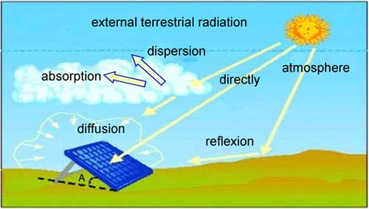
Motivation & goal
Sky imager based shortest-term solar irradiance forecasts for local solar energy applications

Slide 3
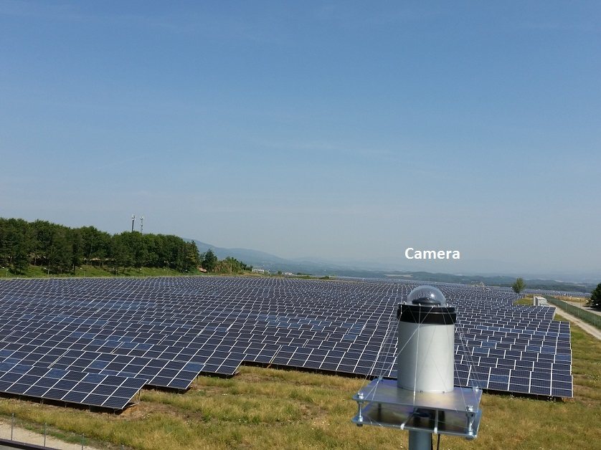
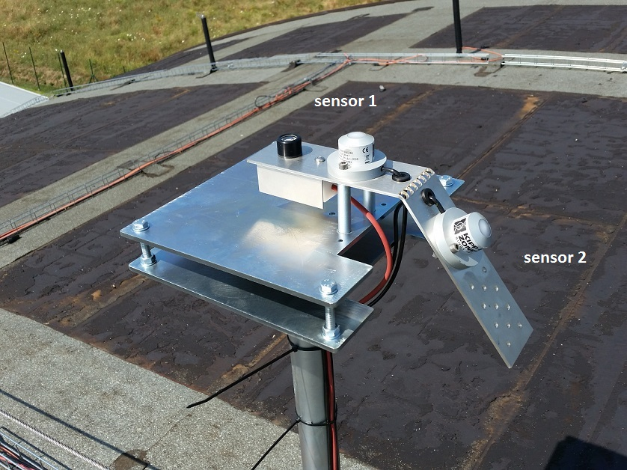
Experimental setup (in Cavriglia)

Slide 4
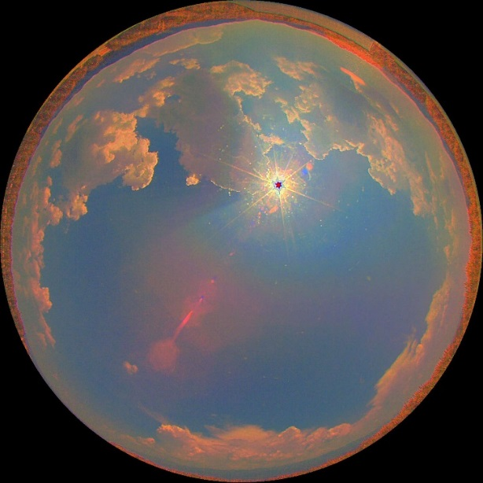
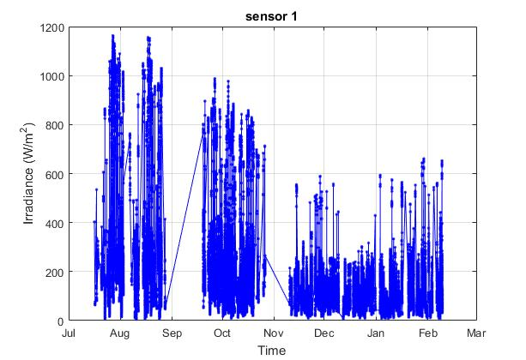
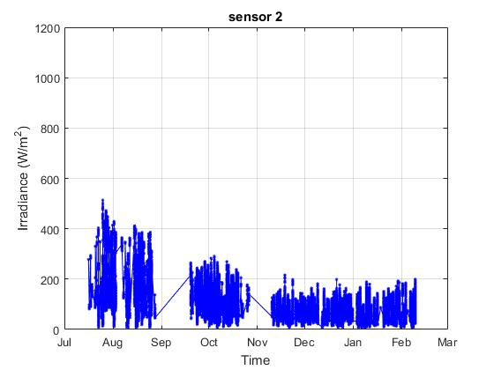
Acquired Data
HDR Images and Irradiance every 8 seconds
power every 3 seconds

Slide 5
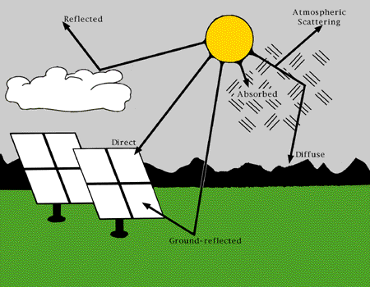
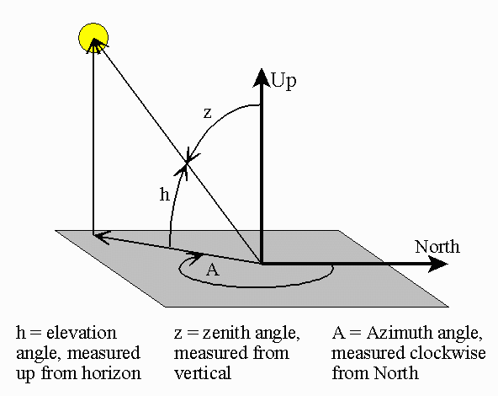

Irradiation components
Global Horizontal Irradiance (GHI)
Diffuse Horizontal Irradiance (DHI)
Direct Normal Irradiance (DNI)
$GHI=DNI ×\cos{(Z)}$ + DHI + reflected

Slide 6
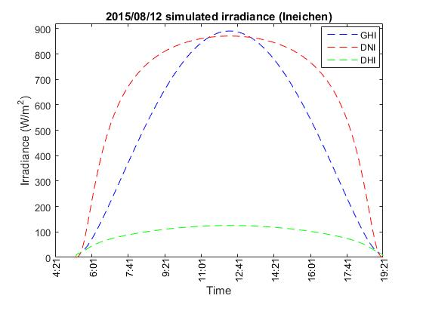
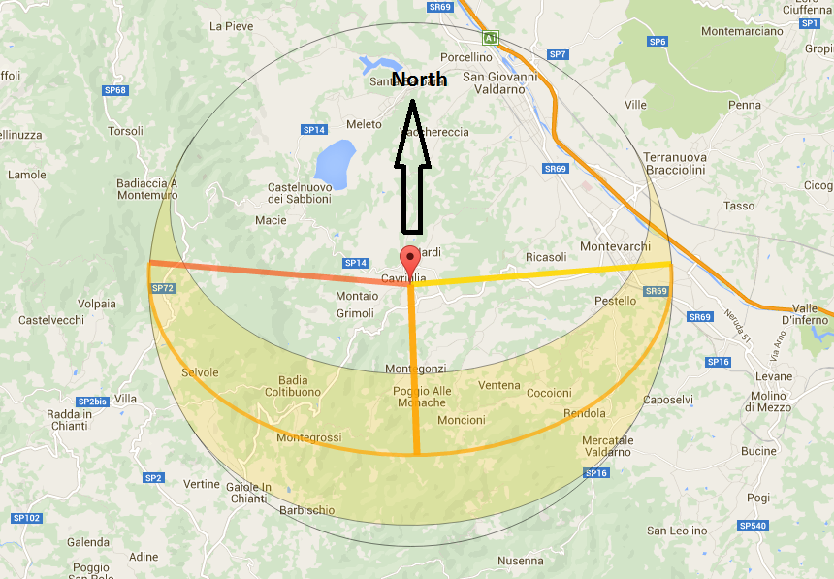
Irradiation components (cont.)
IMPROVE THIS SLIDE

Slide 7
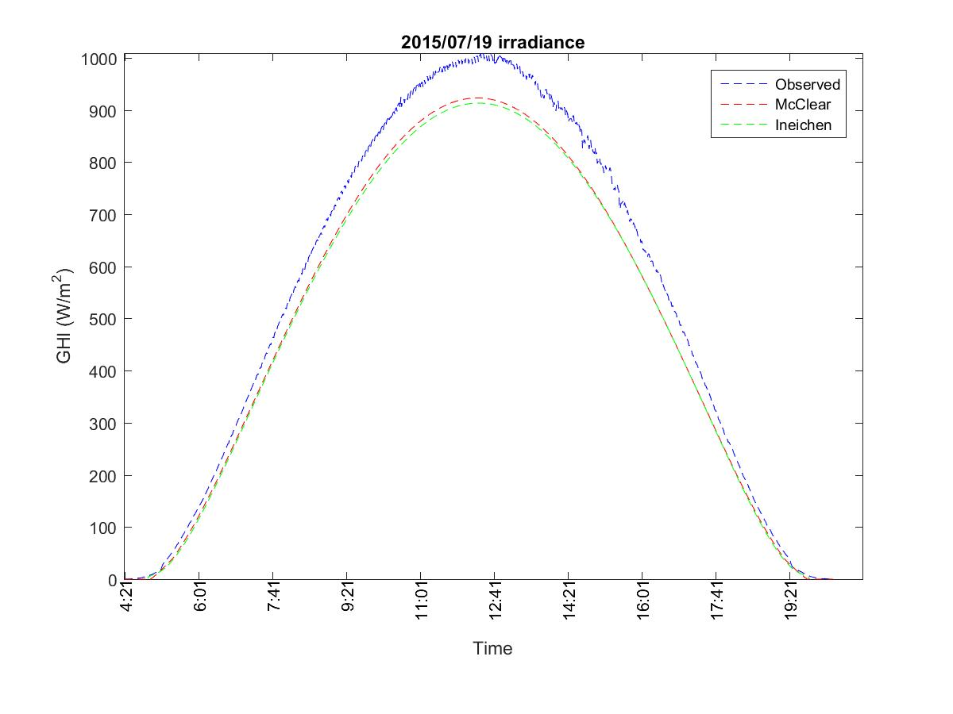
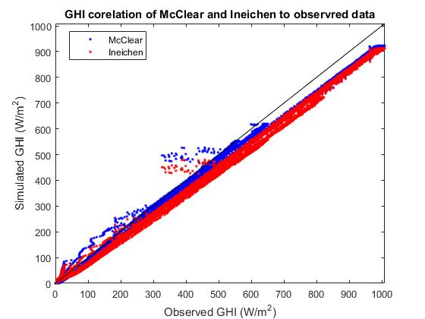
Clear-sky irradiance model

Slide 8
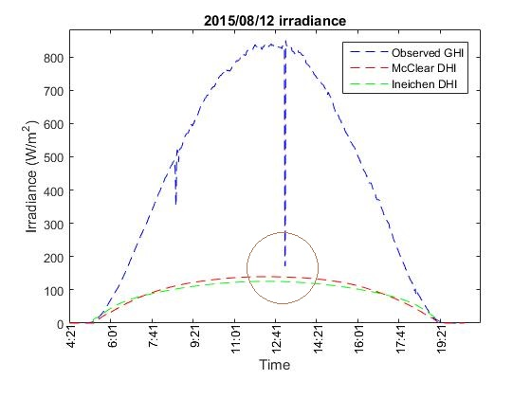
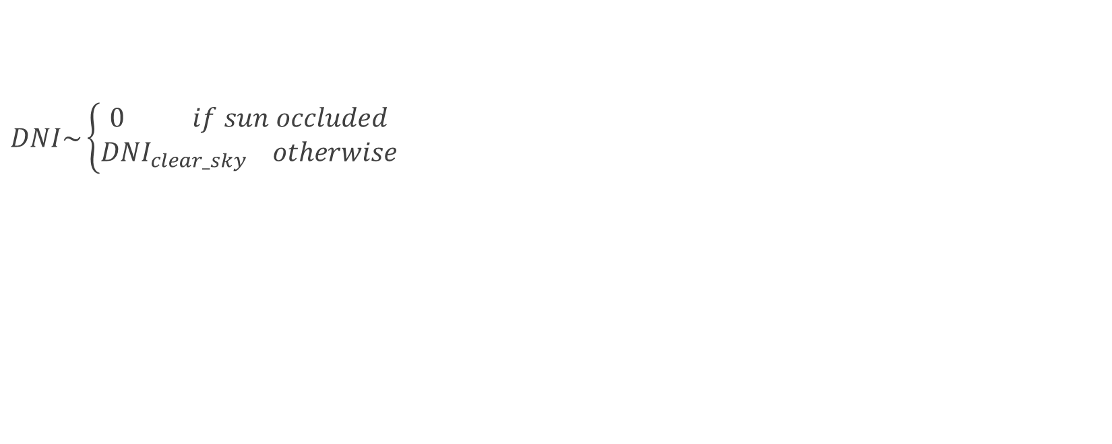

Estimating DNI (from clear-sky model)
$DNI\sim \left\{\begin{aligned}0 if sun occluded \\ {DNI}_{clear_sky} otherwise\end{aligned}\right.$
$GHI=DNI ×\cos{(Z)}$ + DHI

Slide 9
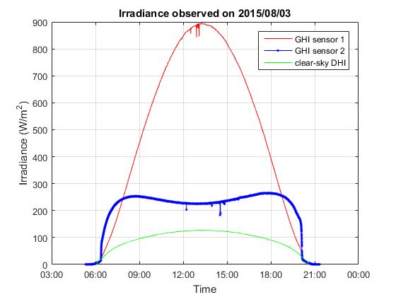
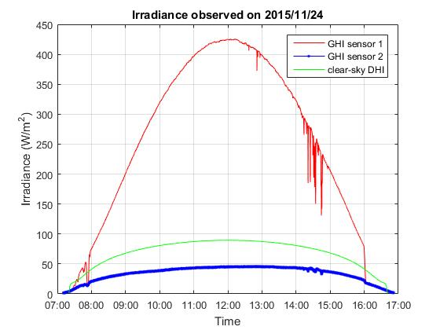
Estimating diffuse from sensors
Notes:
Using clear_sun_flag and estimated DNI for calculating diffuse from tilted plate
We only consider images with complete visible sun or no sun at all.
Extracted diffuse from north-facing plate is more robust than south-facing one

Slide 10
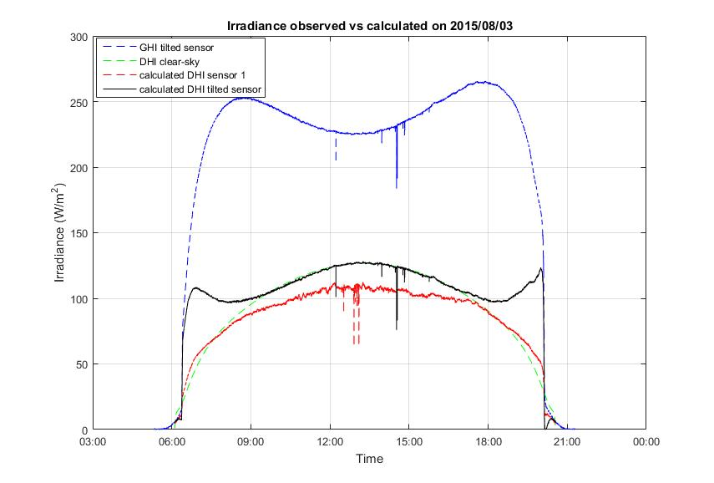
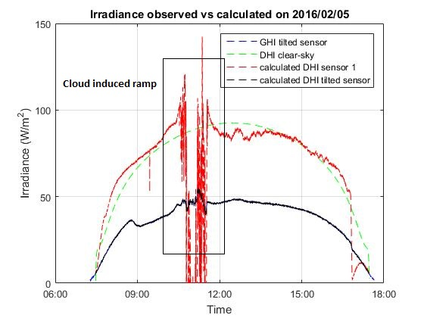
Estimating diffuse from sensors (cont.)
$$θ=Arctan2(\left\|a ⊗ b\right\|, a∙b)$$
Notes:
Using clear_sun_flag and estimated DNI for calculating diffuse from tilted plate
We only consider images with complete visible sun or no sun at all.
Extracted diffuse from north-facing plate is more robust than south-facing one

Slide 11
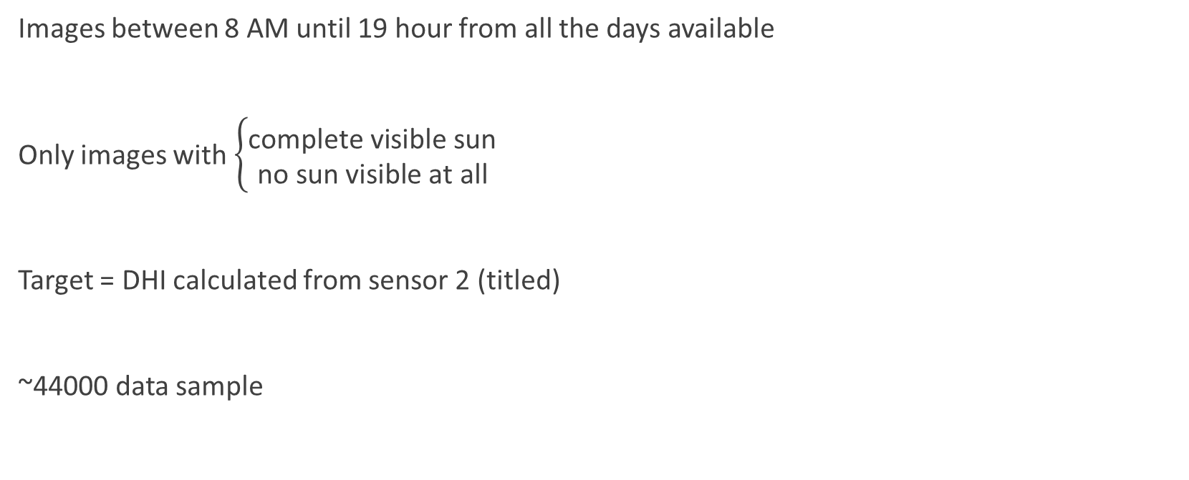
Training data
Images between 8 AM until 19 hour from all the days available
Only images with $\left\{\begin{aligned}\text{complete} \text{visible} \text{sun} \\ \text{no} \text{sun} \text{visible} \text{at} \text{all}\end{aligned}\right.$
Target = DHI calculated from sensor 2 (titled)
~44000 data sample

Slide 12
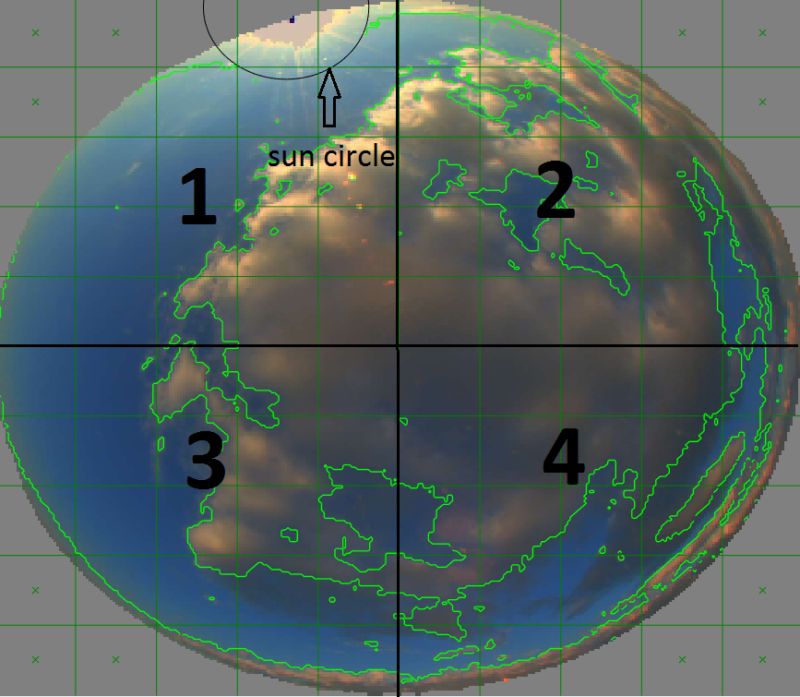
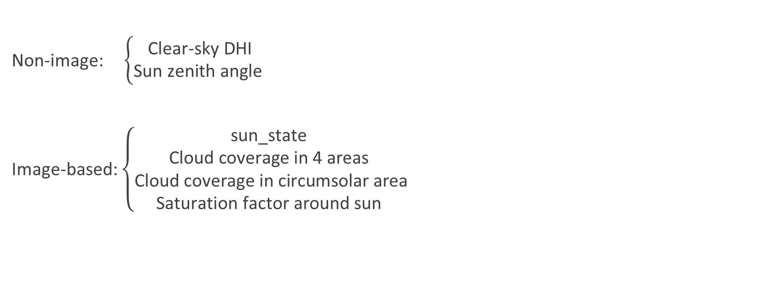
Estimating diffuse from Image features
Non-image: $\left\{\begin{aligned}\text{Clear}\text{−}\text{sky} \text{DHI} \\ \text{Sun} \text{zenith} \text{angle} \end{aligned}\right.$
Image-based: $\left\{\begin{aligned}\text{sun}\text{_}\text{state} \\ \text{Cloud} \text{coverage} \text{in}\text{ 4 }\text{areas} \\ \text{Cloud} \text{coverage} \text{in} \text{circumsolar} \text{area} \\ \text{Saturation} \text{factor} \text{around} \text{sun} \end{aligned}\right.$

Slide 13
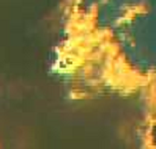
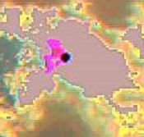
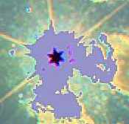
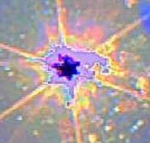
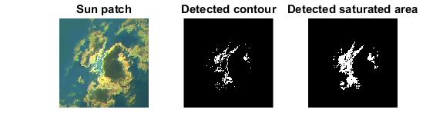
Features (cont.)
1
2
3
4
Sun_flag =
Saturation factor

Slide 14
Learning algorithm
K-nearest-neighbor regression
K=10
Support Vector Machine regression
RBF kernel
Params cross-validated
Linear regression
With feature interactions

Slide 15
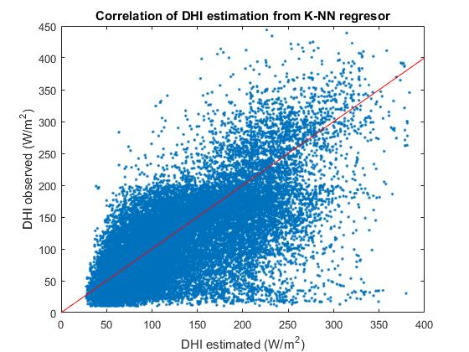
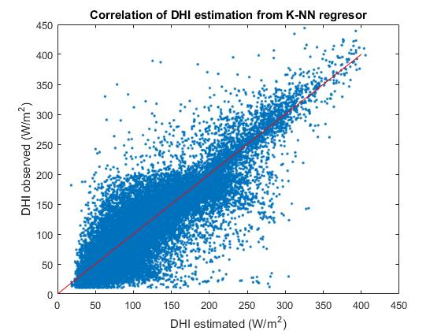
K-NN regression result
Non-image features:
RMSE = 57.4 W/m^2
All the features:
RMSE = 36.2 W/m^2

Slide 16
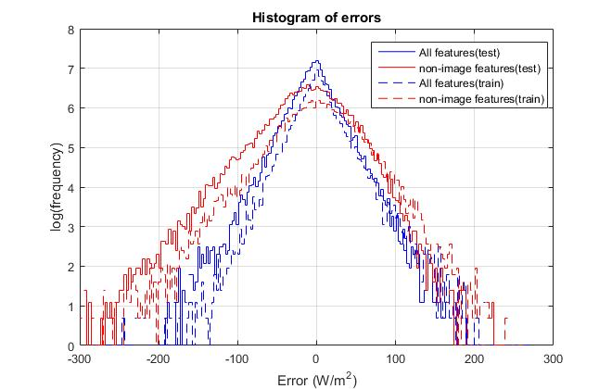
Errors
37% improvement in RSME
Bias towards over-estimating

Slide 17
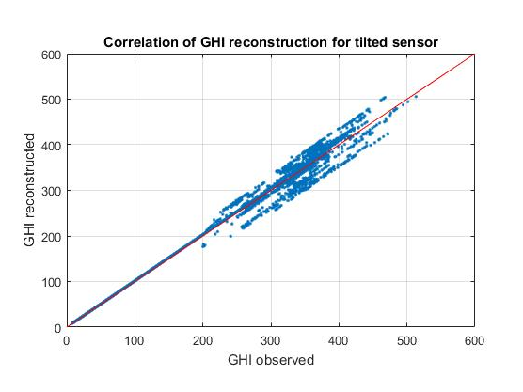
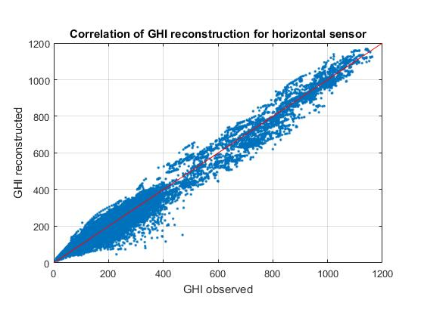
Reconstructing GHI

Slide 18
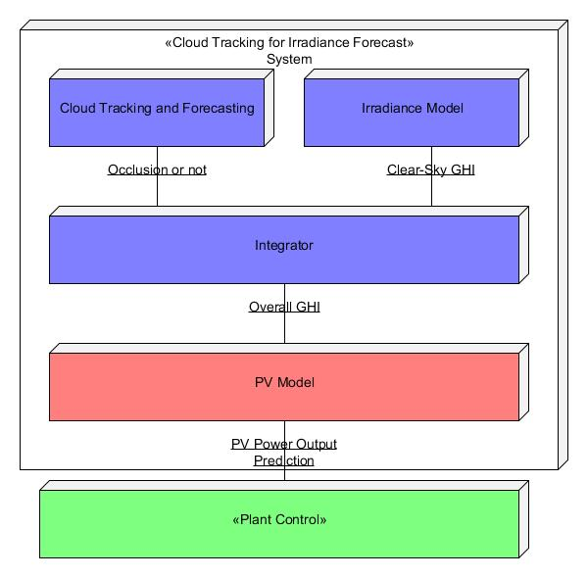
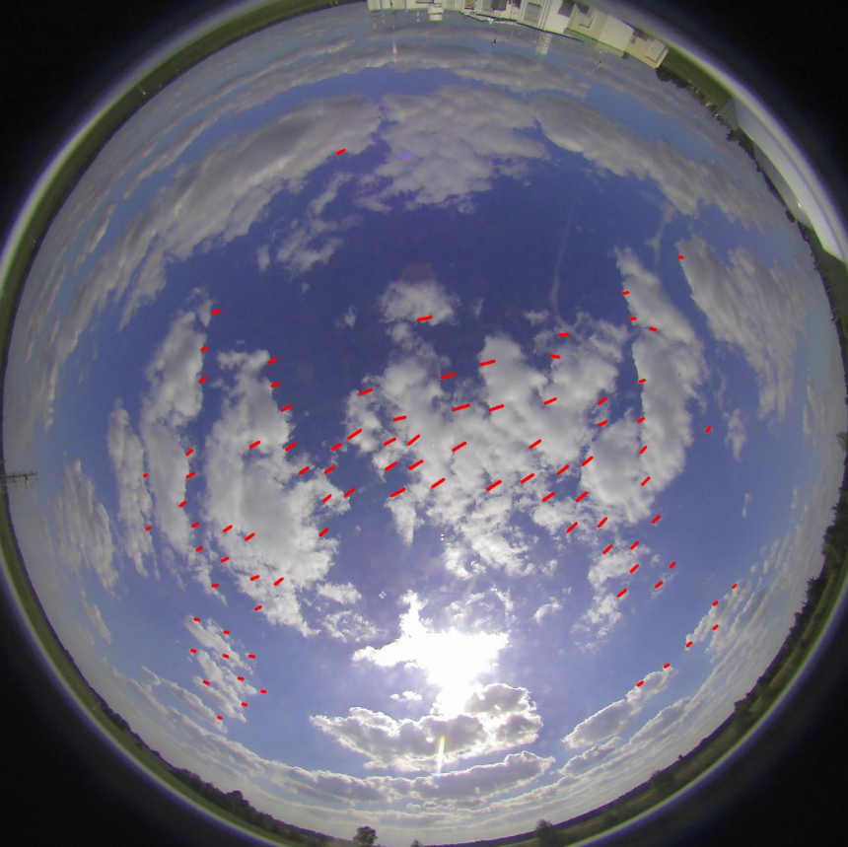
Application in irradiance forecast
Notes:
Using optical flow to extract clouds’ motion vector
Move the clouds with same motion vector

Slide 19
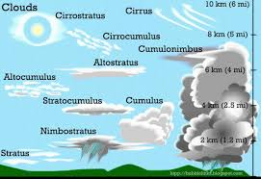
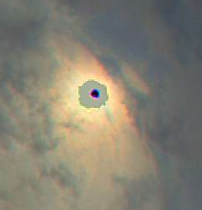
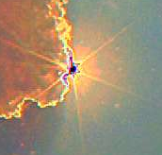
Future work
Consider partial sun occlusion
Cloud type classification

Slide 20
Conclusion
What we wanted to do
Using machine learning on image features
Achieved RMSE 36%

